Slide 1
State of Homelessness in U.S.

Slide 2
Data Cleanup

Slide 3
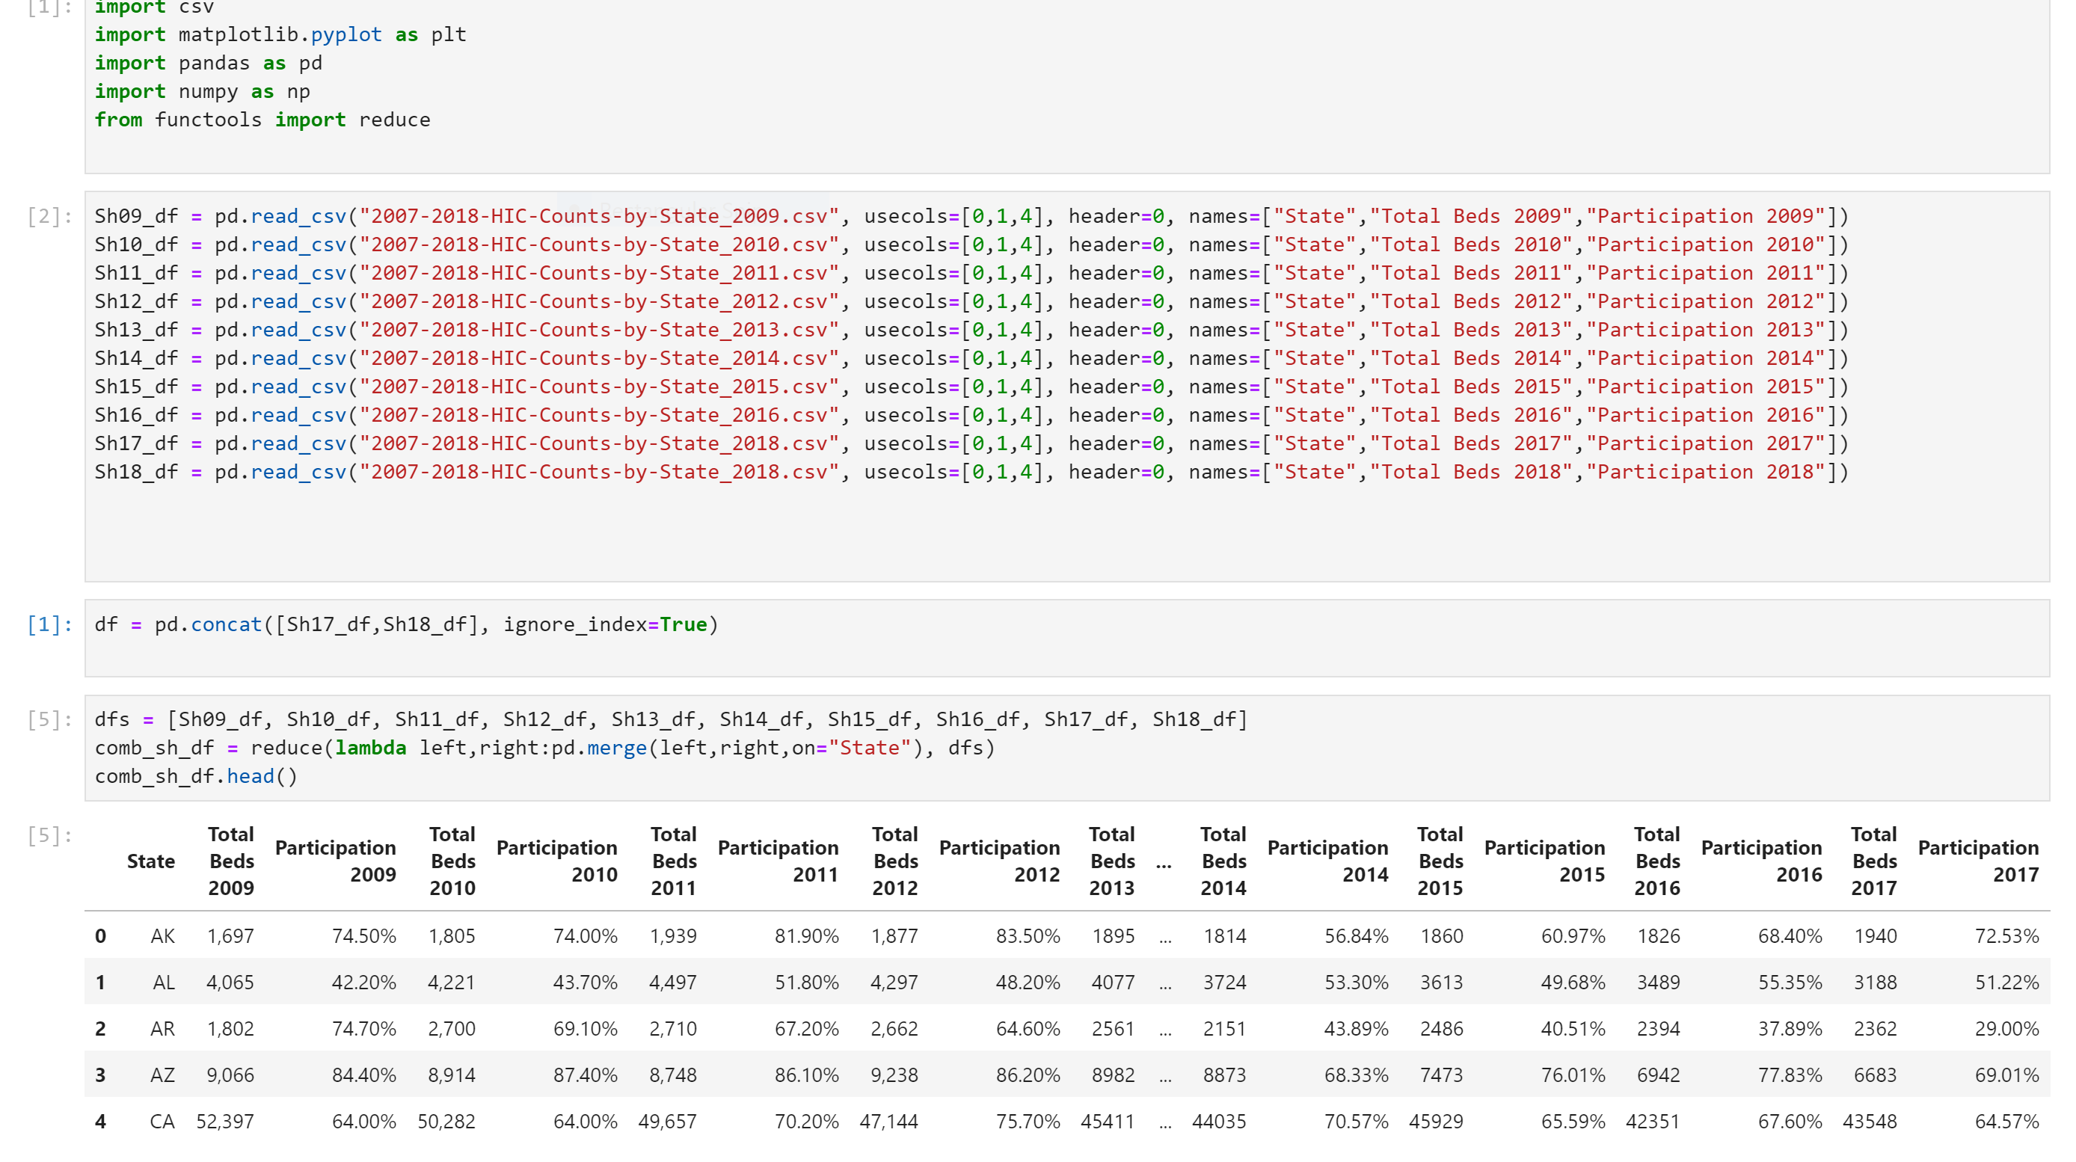

Slide 4
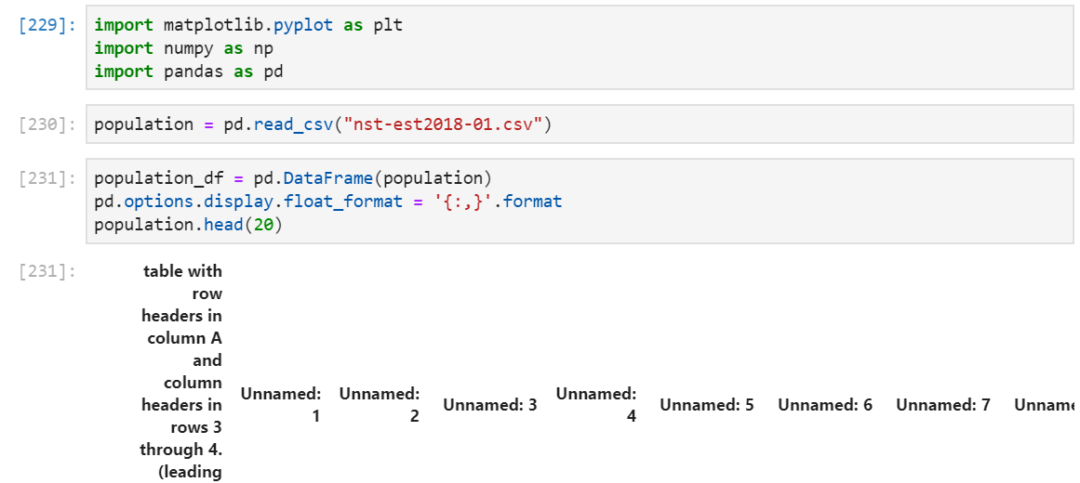
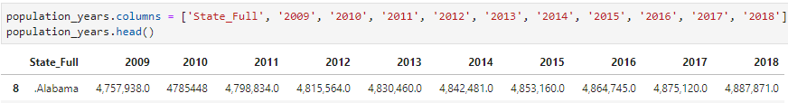
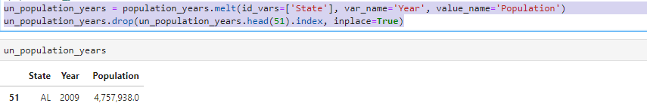

Slide 5
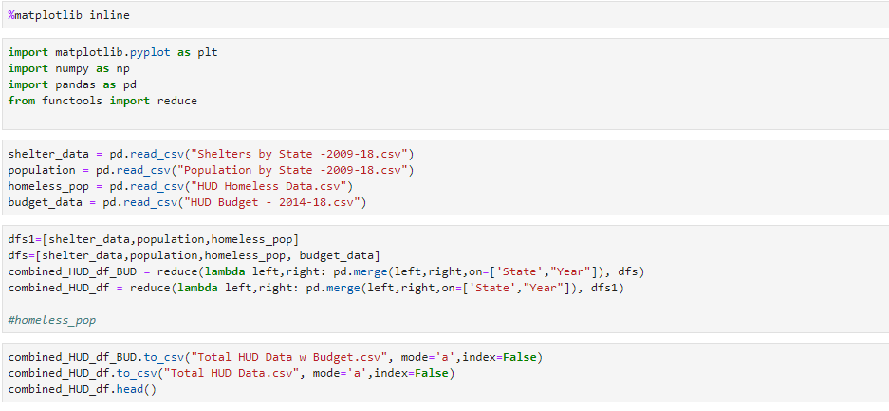

Slide 6
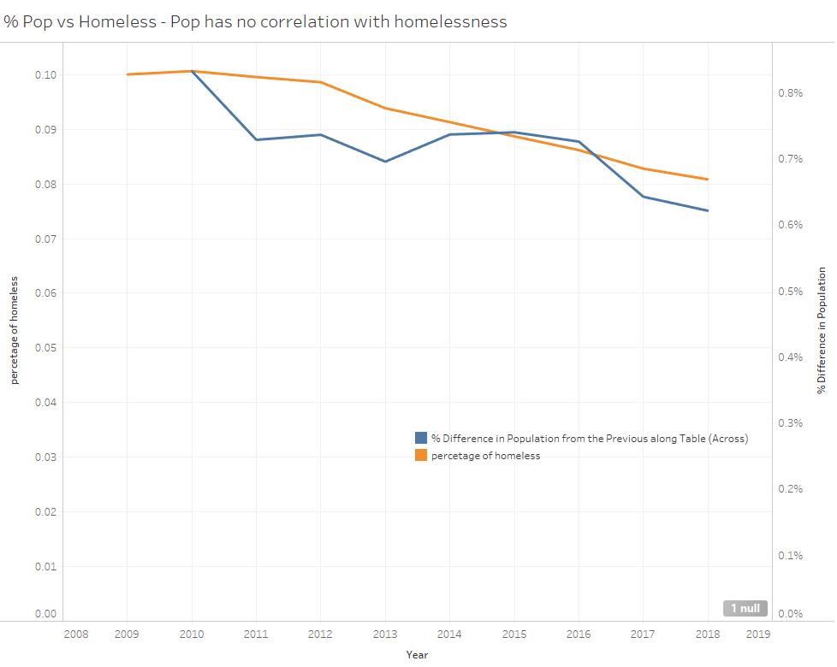

Slide 7
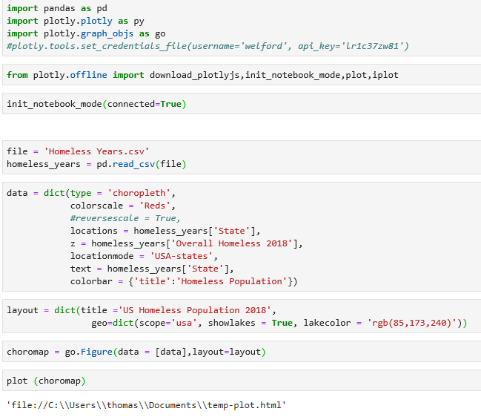
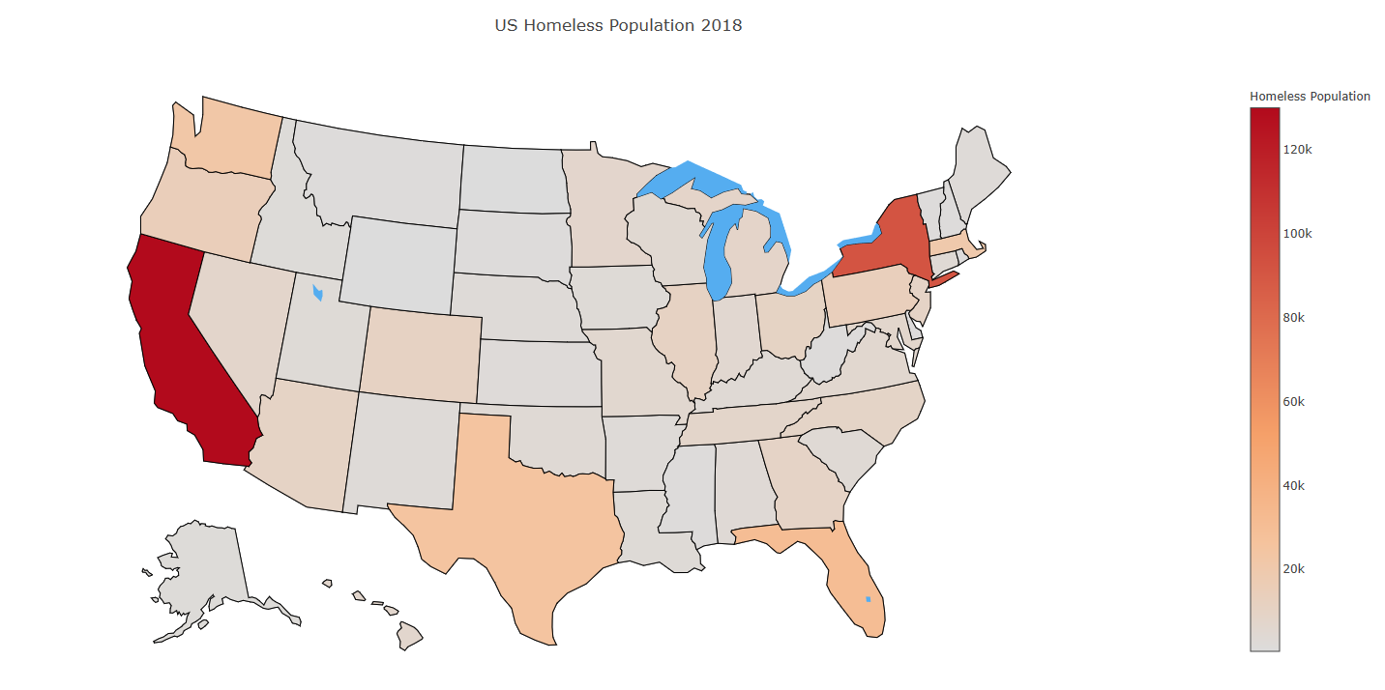
Half of the people that were homelessness in US are in one five states: California 129,972, New York 91,897, Florida 31,030, Texas 25310, and Washington 22,304.
California and New York had the largest numbers of people experiencing homelessness and high rates of homelessness, at 33 and 46 people per 10,000.
Florida (15) and Texas (9) was lower than the national average of 17 people per 10,000.

Slide 8
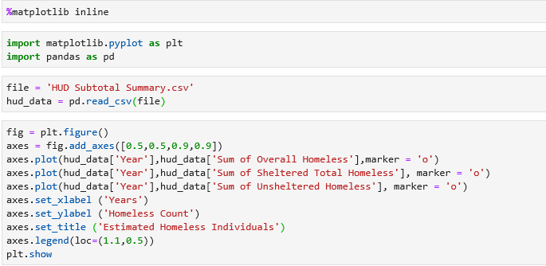
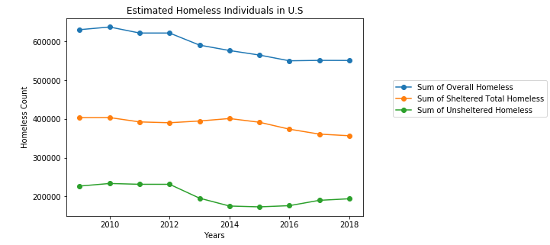
Nearly half of all unsheltered people in the country were in California (47% or 89,543). The state with the next largest number of people experiencing homelessness in unsheltered locations was Florida, with seven percent of the U.S. total (13,393 people)
In four states, more than half of all people experiencing homelessness were found in unsheltered locations: California (69%), Oregon (62%), Nevada (56%), and Hawaii (53%).
Four states—Maine, Rhode Island, New York, and Massachusetts—sheltered at least 95 percent of people experiencing homelessness.

Slide 9
Total Homeless by State vs. Maximum Beds
During our analysis, we decided to dig deeper by state to see where shelters were lacking. Most states were doing well, with some doing better and some doing much worse.
New York shelters 96% of their homeless population, which is .47% of the state’s population
California, on the other hand, only provides shelters for 34% of their homeless that are .33% of the state’s total population

Slide 10
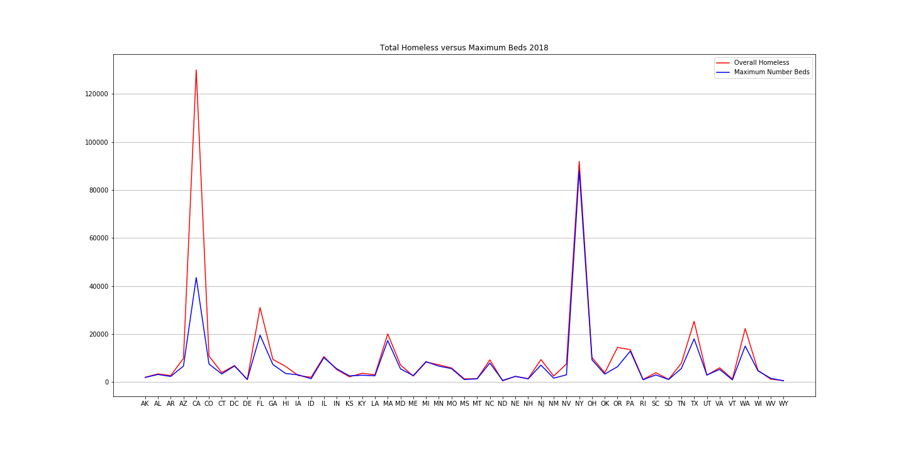

Slide 11
Percent of Homeless to Total Population
We then decided to take the top and bottom 5 states and see what the percentage of homeless was to total population, to possibly see if the poor performing states had a higher homeless population.
Homeless population was not a factor:
New York : .47%
D.C.: .98%
Massachusetts: .29%
The bottom 5 were all below .35%

Slide 12
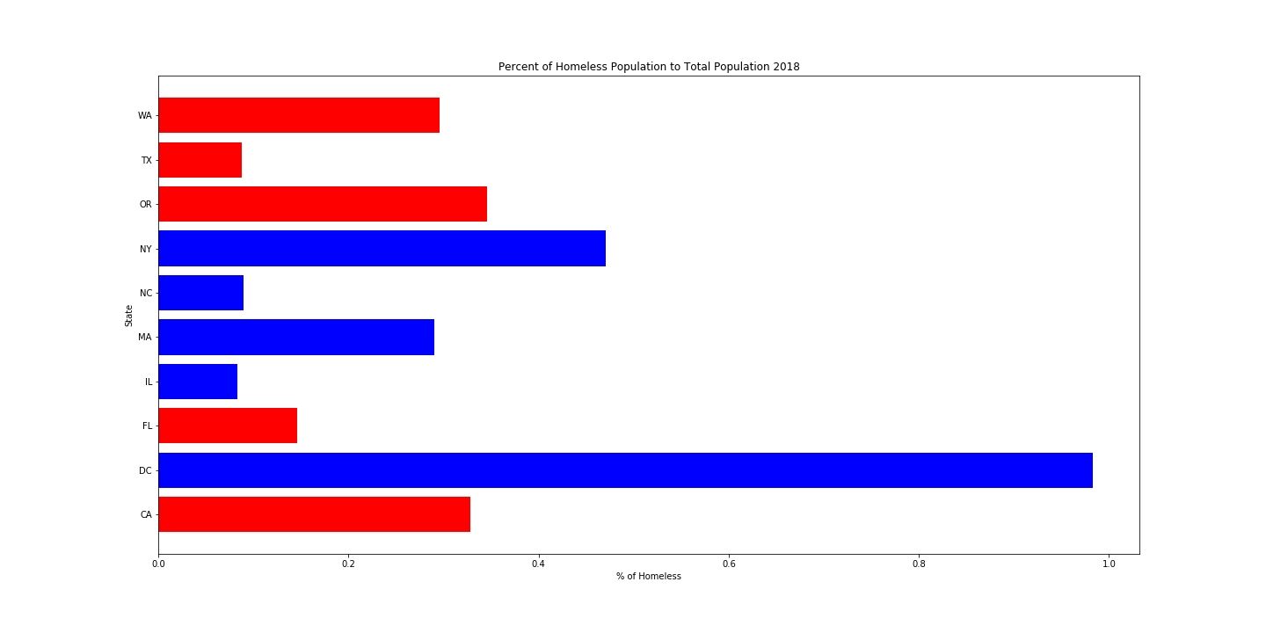

Slide 13
Dollars Spent Per Capita (2018)
The final analysis was to see how much federal money was being spent per capita.
As expected, the top 5 were spending more, but not as much as expected. D.C. was the outlier at over thirty dollars per person, but a majority were +/- $10 per person.
Even states like North Carolina, spent less per capita, but is able to provide shelter for a majority of its homeless population.

Slide 14
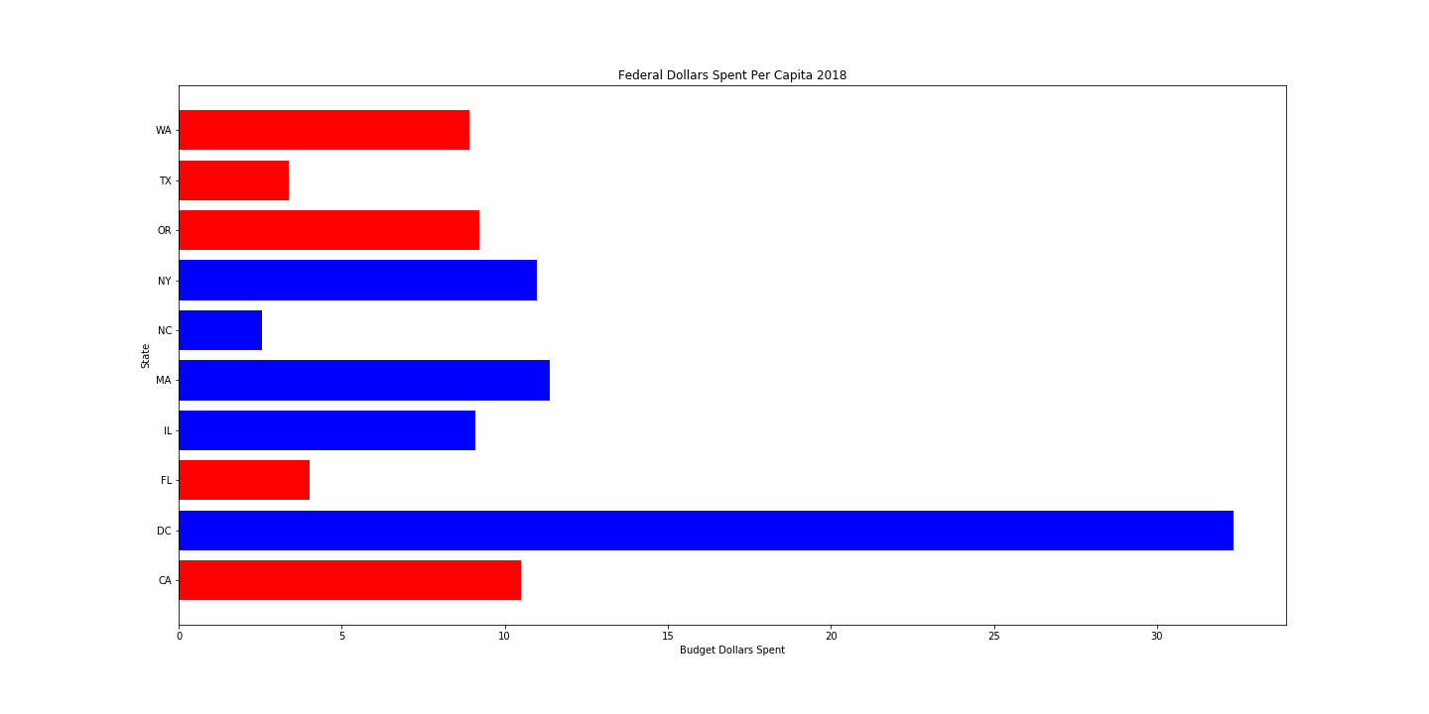

Slide 15
Final Analysis
HUD budget is $26 Billion for 2020. That is a $500 Million increase over the 2018 budget.
Per our analysis, California should receive an increase in budget to provide shelters. However, we should look closer at the allocations for California to be sure money is being spent to house the homeless.
With the remaining bottom four, a slight increase to the annual budget should covers costs to expand homeless shelters.

